Slide 1
Who are these people?

Slide 2
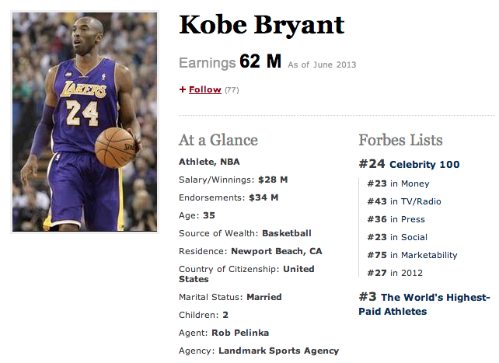
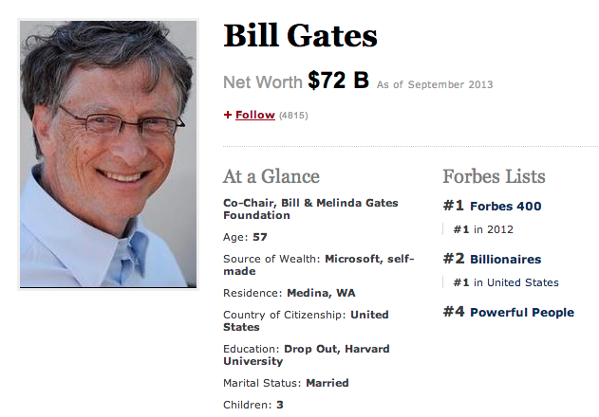
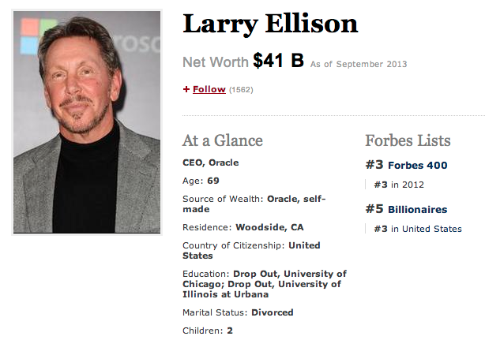
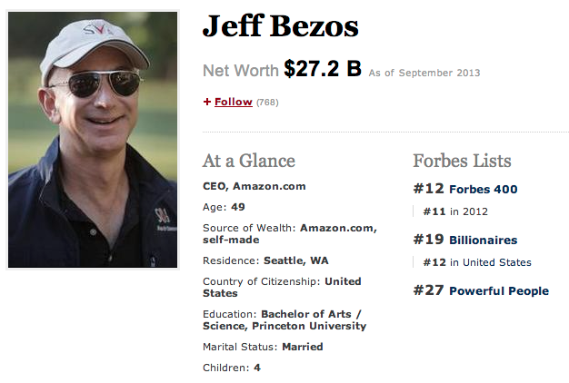
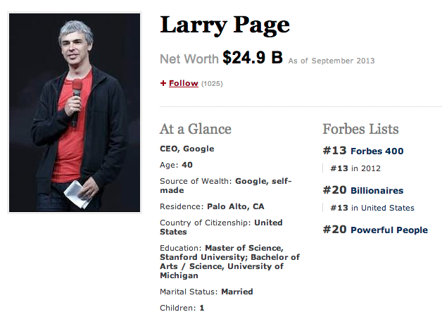
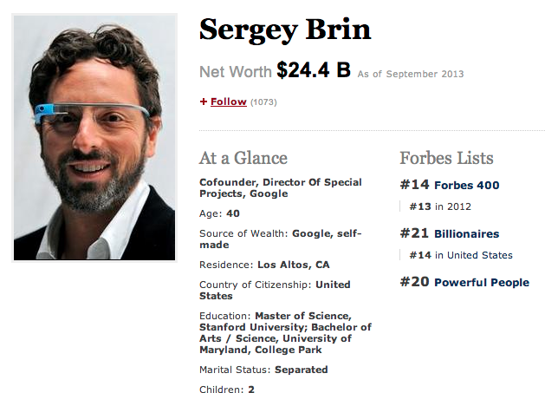
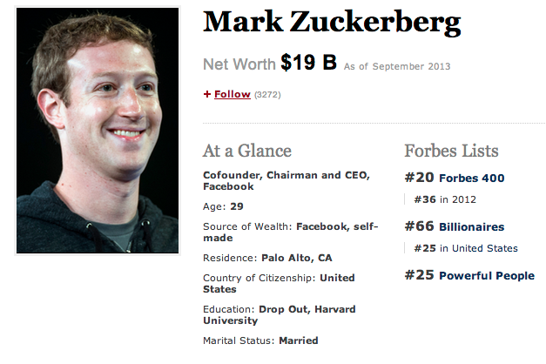

Slide 3
Net Worth: $200M

Slide 10
Who | $$$$ Millions
Koby Bryant | 200
Bill Gates | 72000
Larry Ellison | 41000
Jeff Bezos | 27200
Larry Page | 24900
Sergey Brin | 24400
Mark Zuckerberg | 19000

